Slide 1
Zulfiqar Ali Bhutto Regime

Slide 2
Background
Family background
Political career
Formation of PPP, 1967
1970 elections
Fall of East Pakistan

Slide 3
Civil Chief Martial law administrator
Situation after surrender
Bhutto, the best option for administration
Bhutto, President of Pakistan (22nd Dec, 1971)
Reforms
Hamood Ur Rehman Commission
dealing with political opponents
Screening of Government Servants, 10th March, 1972

Slide 4
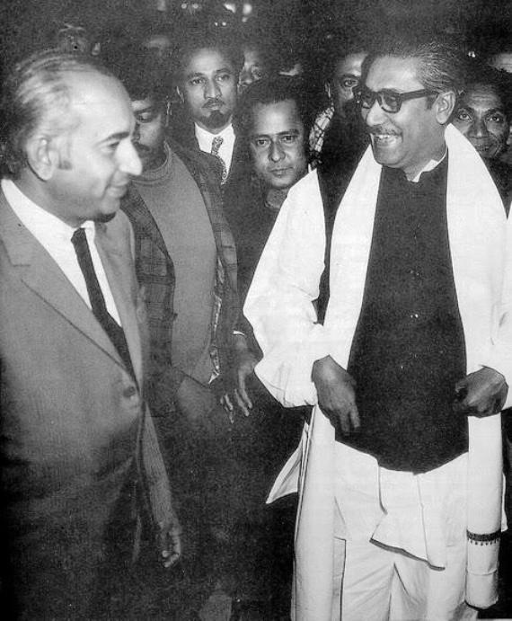
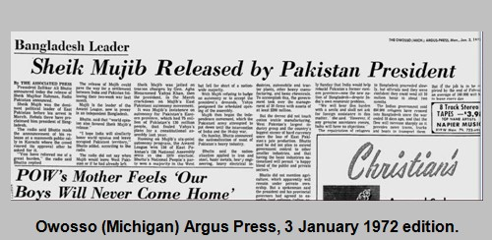
Release of Mujeeb
Public meeting on 3rd January, 1972
Criticism on Bhutto

Slide 5
Centre State Relations
1973 Constitution
Sindhi language movement
Formation of MQM
Balochistan operation
Ministry of Ghulam Mustafa Khar in Punjab

Slide 6
Policies Of Bhutto
Agricultural reforms
land limit
Taxes on landlords
security to tenants
Reaction towards land reforms
Education reforms
Nationalization of institution
Teacher’s salaries

Slide 7
Double shift program
Free primary education
Government pay scales
Industrial Reforms
Nationalization
Labour policy
National ID cards
Pakistan Nuclear power program
Shimla agreement

Slide 8
Bhutto and Islam
Relations with the Muslim countries
Movement for the finality of Prophet Muhammad
1973 Constitution

Slide 9
Downfall of Bhutto
1977 Elections
Protest by the political parties
Martial law by General Zia
Judicial murder of Zulfiqar Ali Bhutto

